Slide 1


👋
Hey Everyone
Abdul Rehman
Gold MLSA
Master Open Source:
Hack the Hacktoberfest with GitHub

Slide 2


Slide 3

Learning Objectives
- Git, GitHub Fundamentals
- Hacktoberfest Tips
- Open-Source Guidance
- Hands-on experience
- Interactive Q&A

Slide 4
Git
Git is a Distributed Version Control System.
Version Control System are software tools that help us to track/mange the changes in our code.
Popular
Free and Open Source VCS
Fast and Scalable
https://git-scm.com/

Slide 5
GitHub
GitHub is a website/platform that allows developers to store and manage their code using Git.
Globally use by developers
Acquired by Microsoft (2018)
Manage Projects
Open Source
Work Together
And many more...
https://github.com

Slide 6

Setting up Git
Windows (Git Bash)
Mac (Terminal)
Visual Studio Code
Git Configuration:
git --version
git config –global user.name “your-name”
git config –global user.email “your-email”
git config --list
https://git-scm.com/

Slide 7
Initialization
Use to initialize/create new git repo.
git init
Clone Command
Use to clone the repository from GitHub to our Local Computer
git clone [Repo URL]

Slide 8
Add, Commit and Push
add:
Adds new or changed files in working directory to Git staging area.
commit:
It is the record of change.
push:
It will upload local repo to remote repo will all changes and commit.

Slide 9

Git Branches
branch:
A branch represents an independent line of development.
Image Source: https://www.nobledesktop.com/learn/git/git-branches

Slide 10
Pull Command
The git pull command is used to fetch and download content from a remote repository and immediately update the local repository to match that content.
git pull origin main

Slide 11
What is Fork?
A fork is a new repository that shares code and visibility settings with the original “upstream” repository.

Slide 12

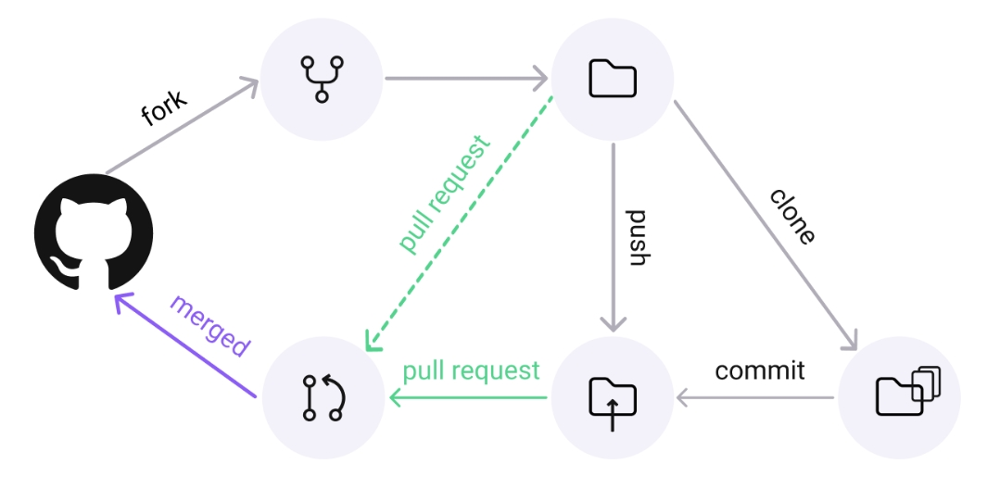
Workflow
GitHub Repo -> Clone -> Changes -> Add -> Commit -> Push
Image Source: https://www.legitsecurity.com/blog/github-privilege-escalation-vulnerability

Slide 13
Open Source
Open-Source Software/Tools or Projects
Code is publicly available to use and modify.
1: Hacktoberfest 2: Google Summer Of Code(GSoC) 3: Google Season Of Docs
4: Outreachy Internship 5: Hyper ledger Mentorship Program
6: MLH Fellowship 7: Reinforcement Learning Open Source Fest
8: The X.Org Endless Vacation Of Code (EVoC)
9: Linux Foundation Networking (LFN) Mentorship Program
and SSOC, SWOC, GSSOC

Slide 14
Publish Site on GitHub
We can publish/deploy our websites on GitHub by using GitHub pages.

Slide 15

Helpful Resources
Git Cheat Sheets:
https://github.com/AbdulRehmanGHub/MLSA-Materials-by-Abdul_Rehman/blob/main/Git%20Cheat%20Sheet.pdf
Download Git:
https://git-scm.com/
Download VS Code:
https://code.visualstudio.com/download
GitHub Education:
https://github.com/education?wt.mc_id=studentamb_267048
Hacktoberfest Site:
https://hacktoberfest.com/

Slide 16

?
Q & A Session

Slide 17






Thank You 😊
I will be happy to connect with you
: https://www.linkedin.com/in/abdulrehman0/
: https://linktr.ee/devabdulrehman
: https://twitter.com/devabdulrehman
: https://medium.com/@abdulrehman0
: https://github.com/abdulrehmanghub
Abdul Rehman

